Slide 1
Library Management System
Presented By-
JISON JAMES

Slide 2
Project Definition
To develop a project titled “Library Management System” and is developed to maintain the operation done in a library.
To Ease the transaction done in library by making all the process online .

Slide 3
Problem Statement
In any Library, All records are maintained in registers.
More manual work.
The lack of consistency in register maintenance leads to both loss of work as well as time and money .

Slide 4
SOLUTIONS
This project “library Management System” mainly focuses on basic operations of library like add the book, delete book, search book, add student etc.
Librarian can issue the books and students can borrow and return the books.
Less paper work.

Slide 5
SOFTWARE REQUIREMENTS
Front end –
Visual Studio ( )
Back end –
Eclipse ()
MySQL server
Tomcat()

Slide 6

Architecture Of Project

Slide 7
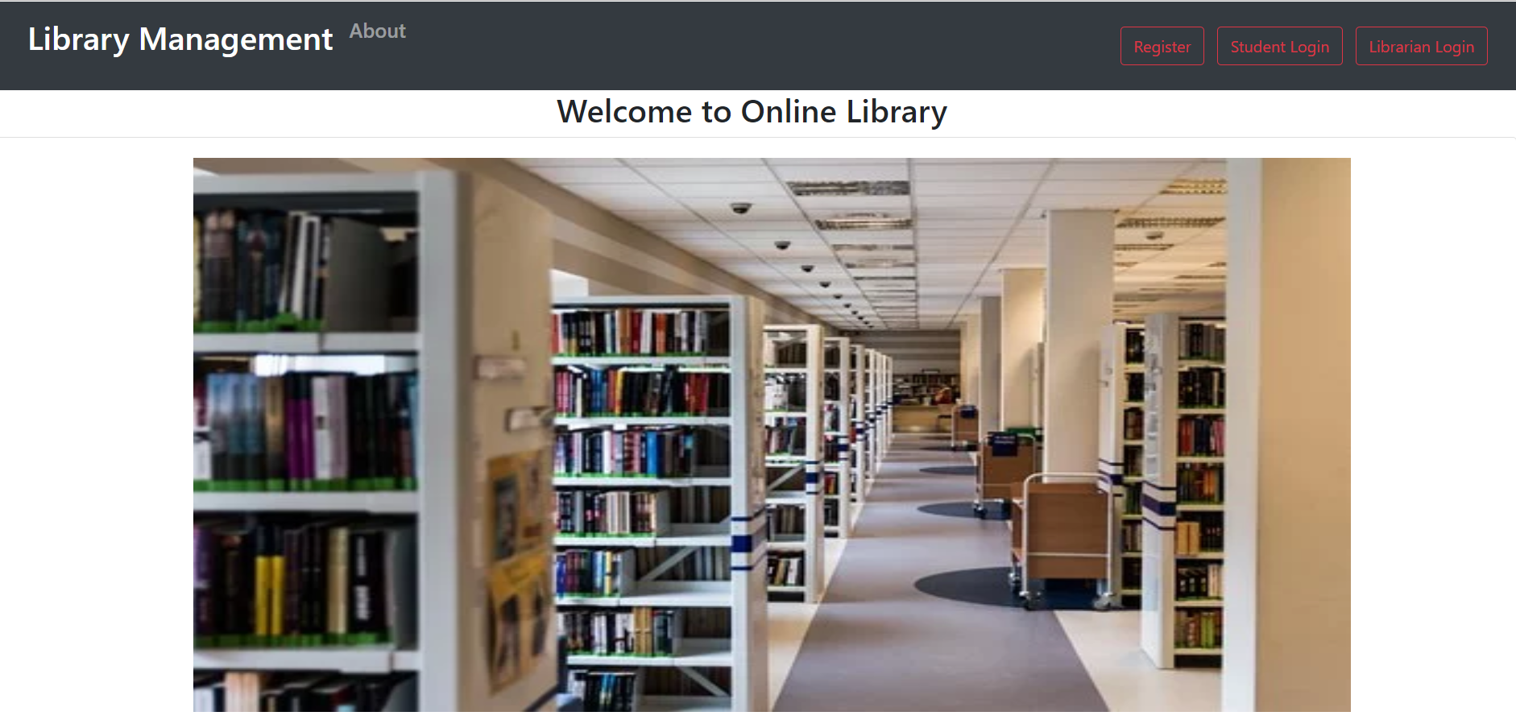
HOME PAGE

Slide 8
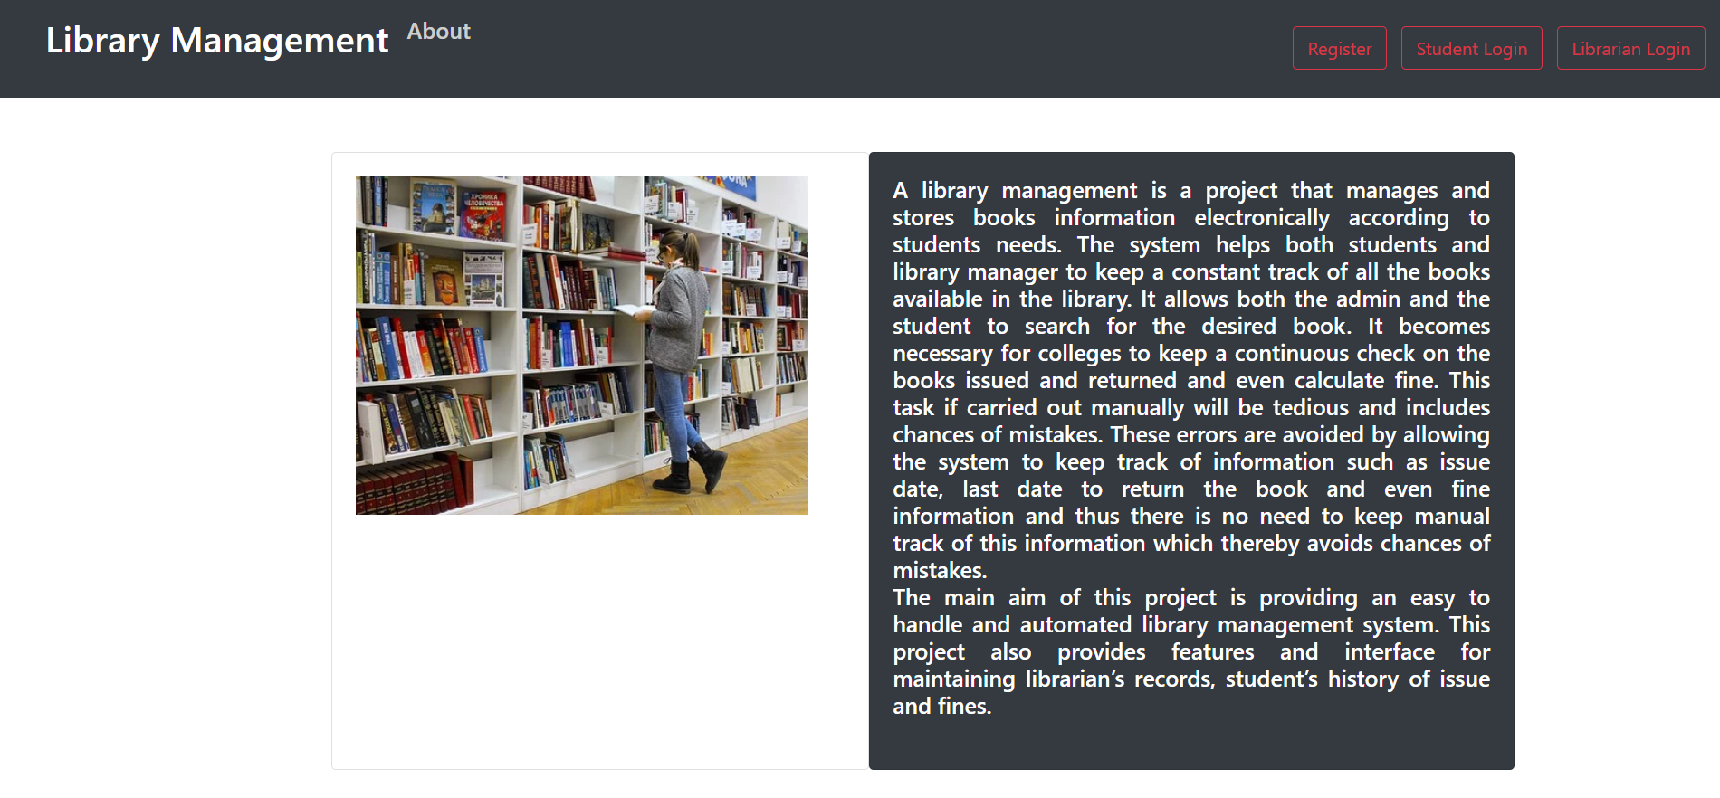
About Us

Slide 9
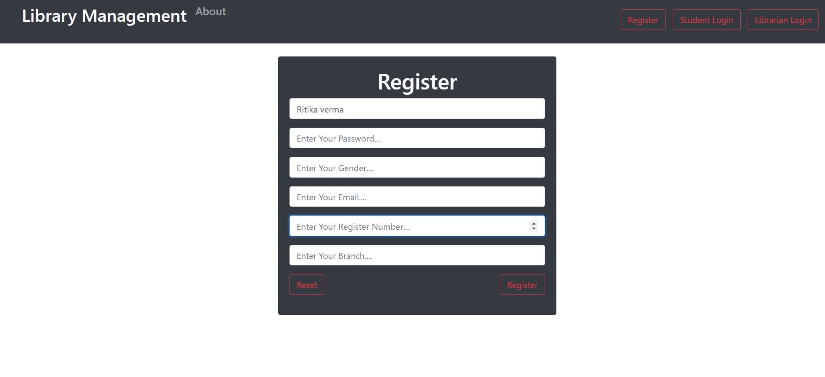
Student – registration and login

Slide 10
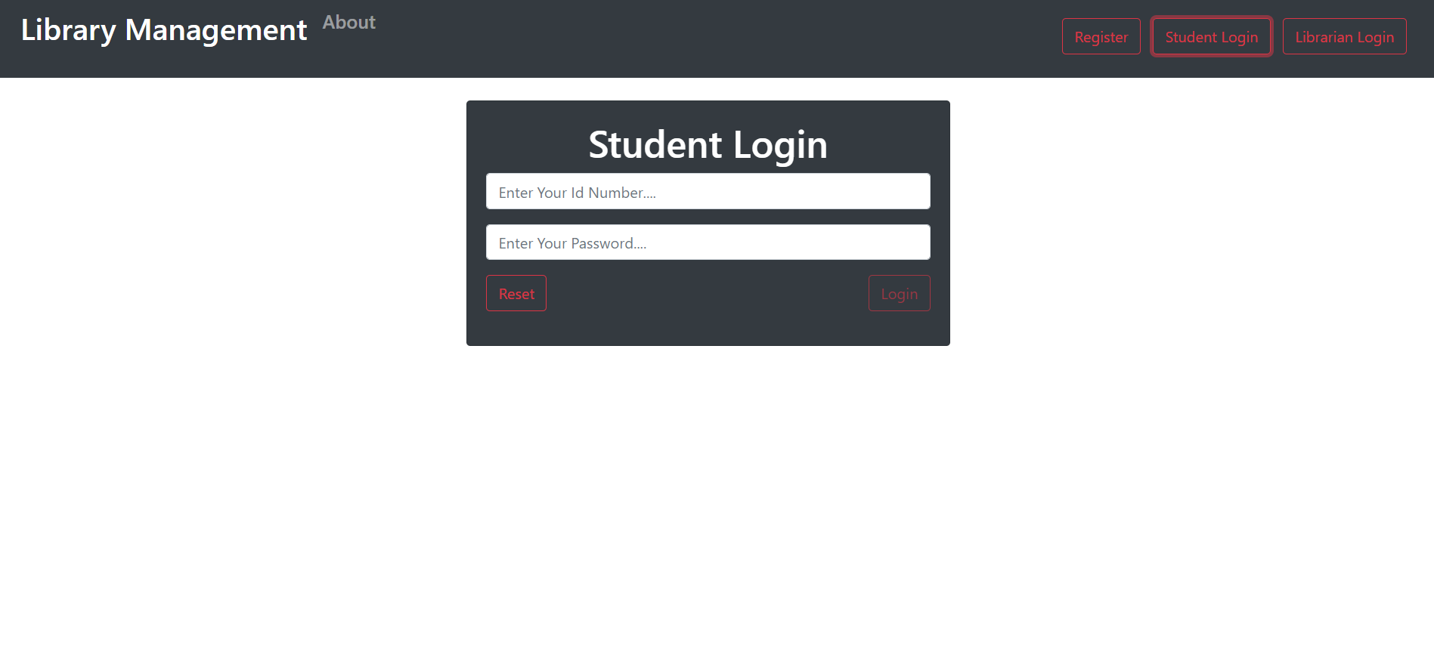

Slide 11
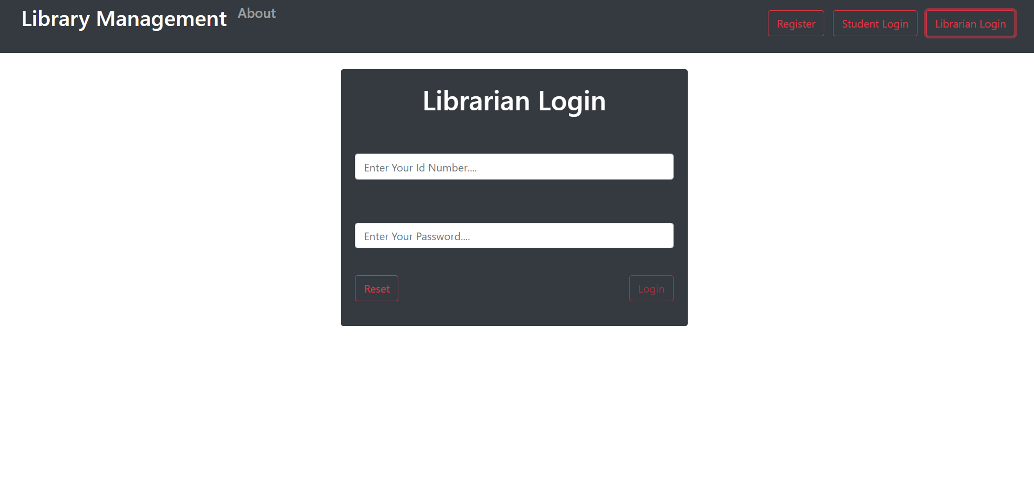
Librarian login

Slide 12
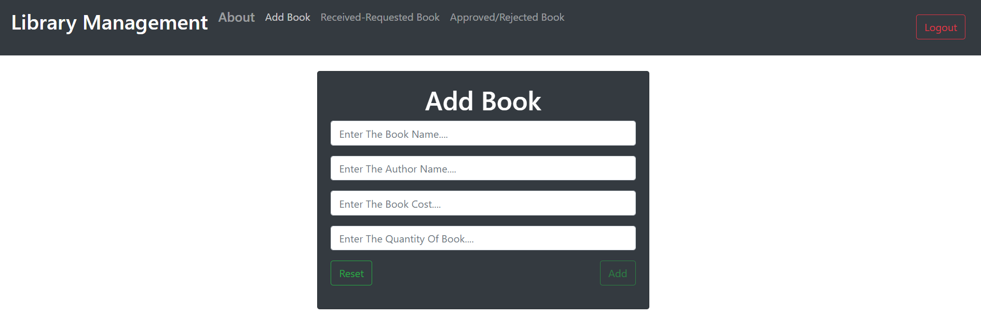
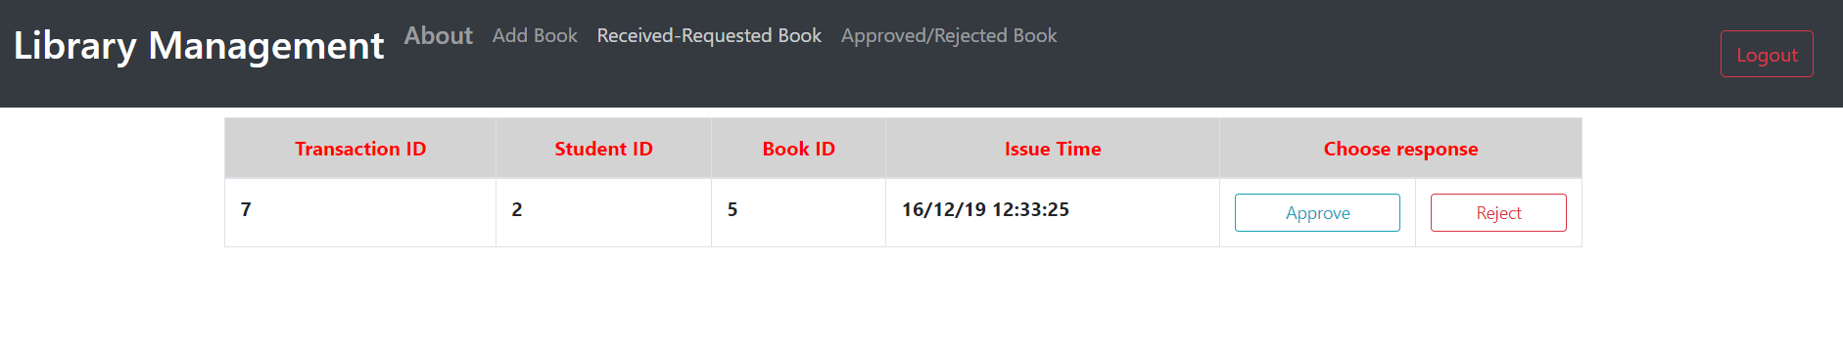

Slide 13
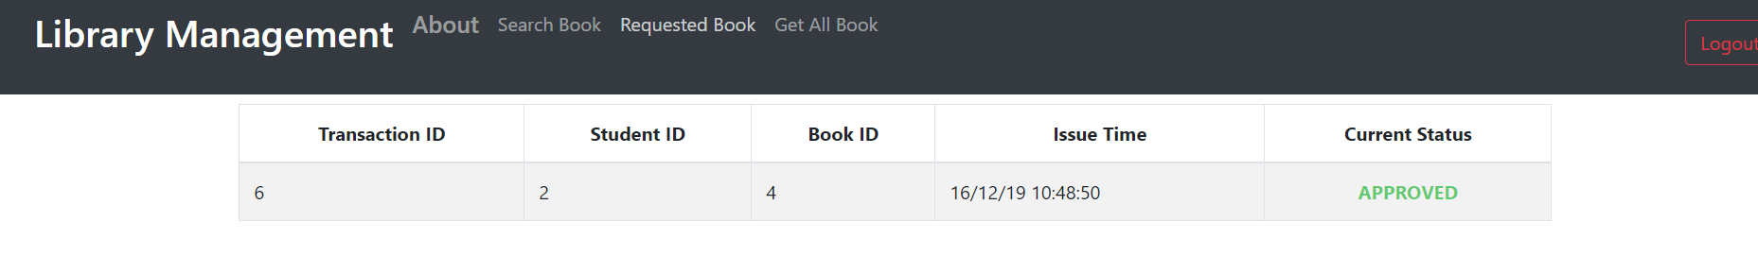

Slide 14
Flow chart
Start
Admin
Student
Login
Login
Add Book
Issue Book
Search Book
Request Book
Return Book
Update book
Return Book
Update
Logout
Stop

Slide 15
Modules
In this project, We have following modules-
Admin Module
Student Module
Librarian Module

Slide 16
CONCLUSION
Computerized Library System is more efficient.
It reduces most of the paper work.
Compare between current system or automated system, Automated System is best.

